Slide 1
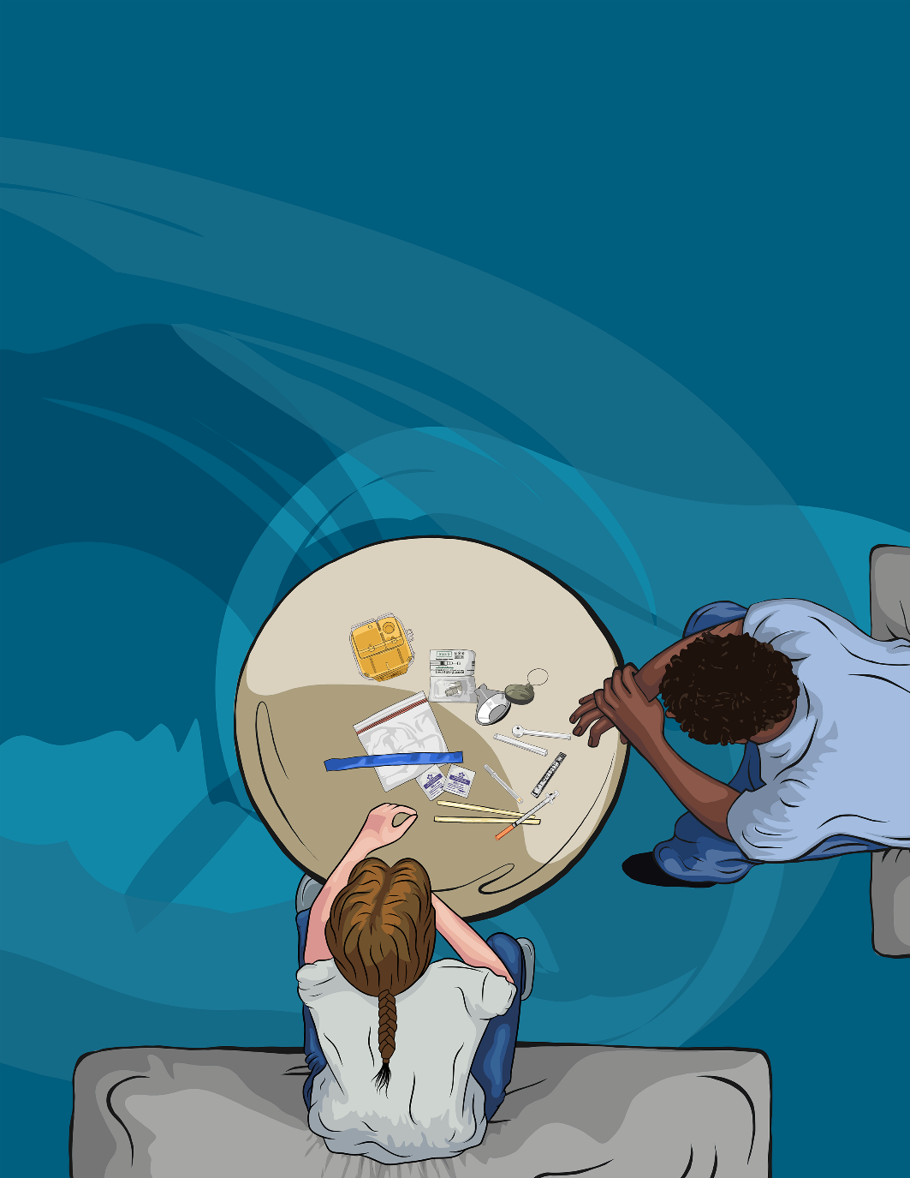
Connecting
A webinar on new guidance for using harm reduction supplies as engagement tools
May 12 2021 | 10:30 - 11:30 AM
ohrn.org
ohrdp.ca

Slide 2
Do I need to read what’s in here? Is it of interest? Is it applicable to me?
Quote from focus group participant

Slide 3
Posters can be a very important tool in conveying the first harm reduction messages to clients A colourful poster that we can have in a staff room or on office walls that clients can see and benefit from.
“
Quote from focus group participant

Slide 4
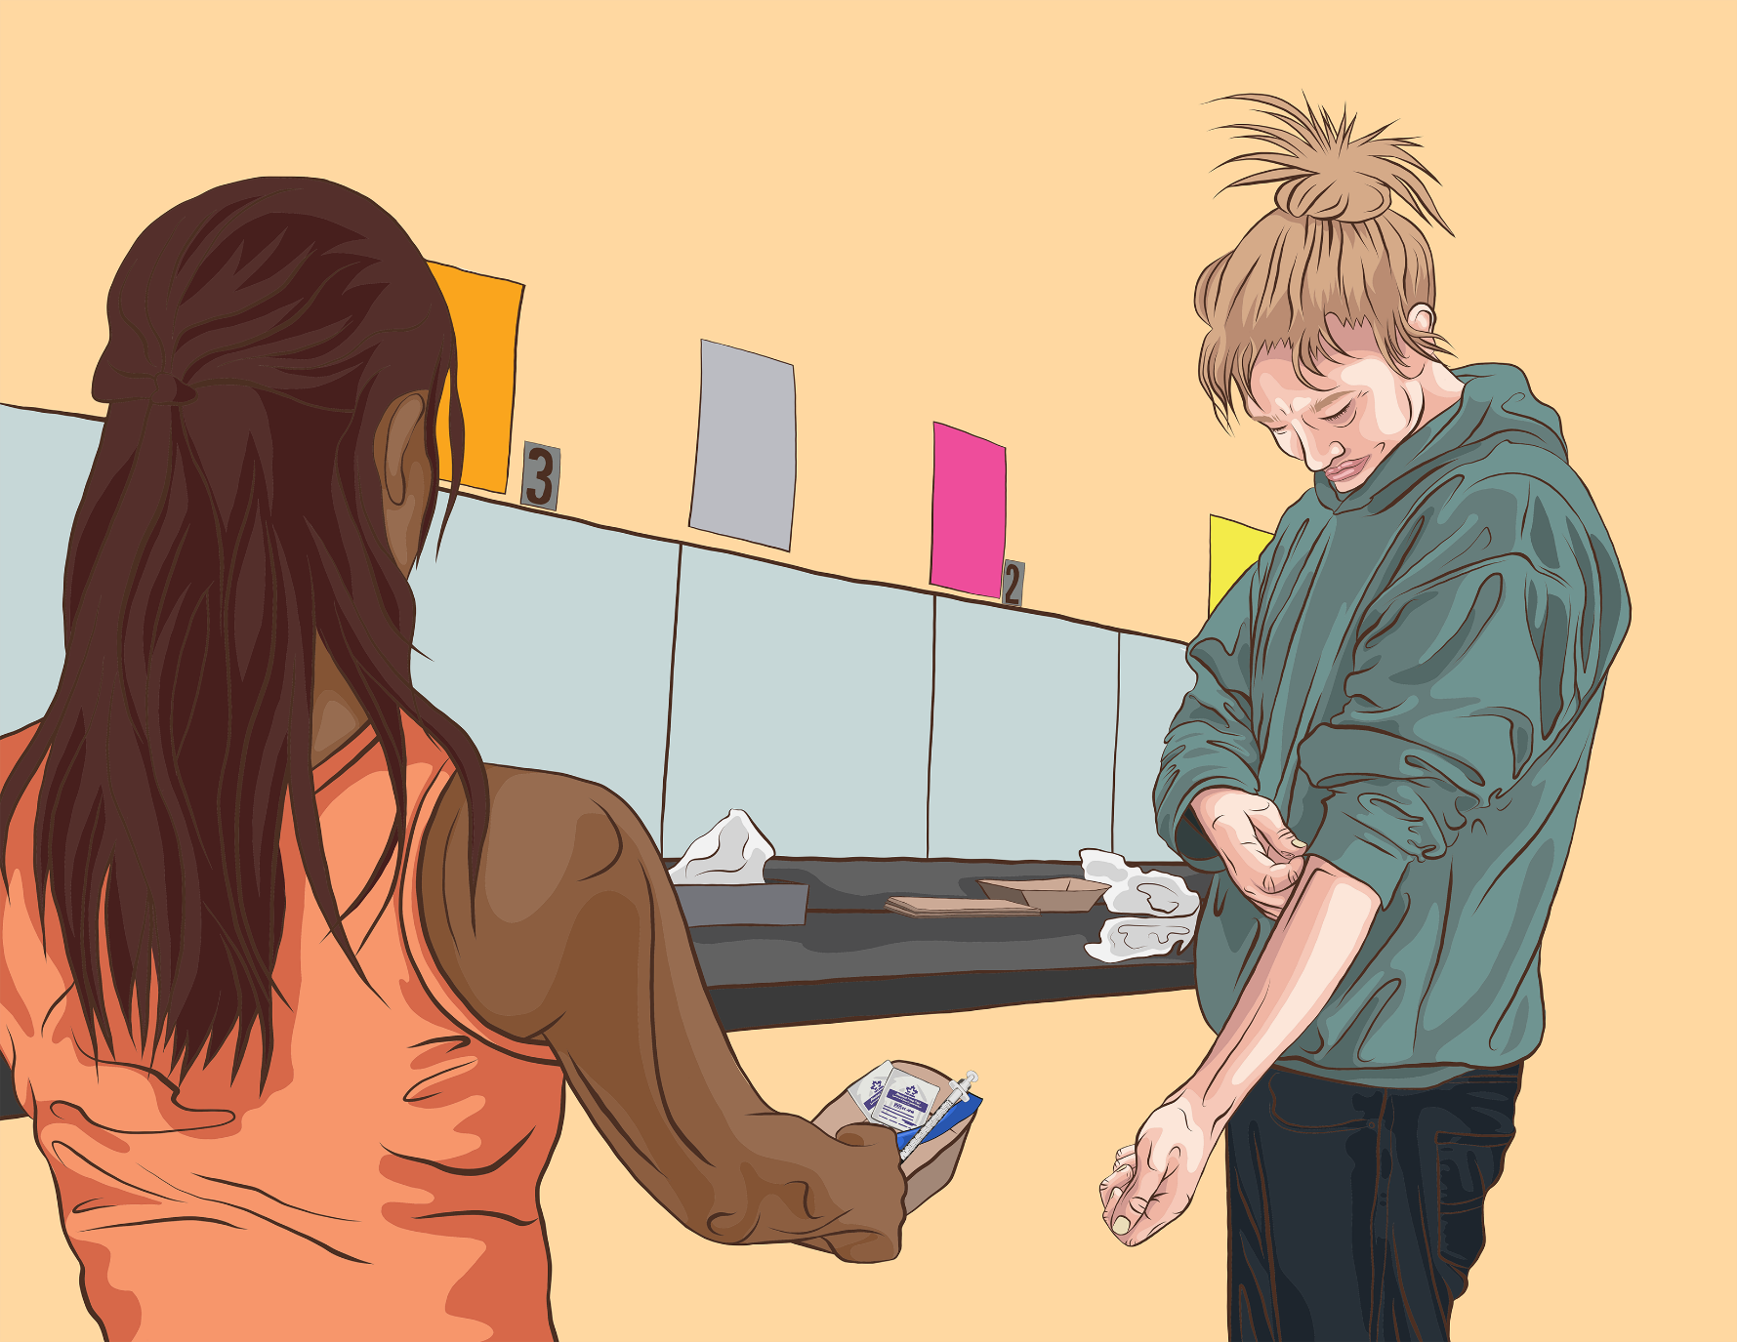
So we want you to see step-by-step how to do something. We want our clients to see that and we want it for ourselves as well.
“
Quote from focus group participant

Slide 5
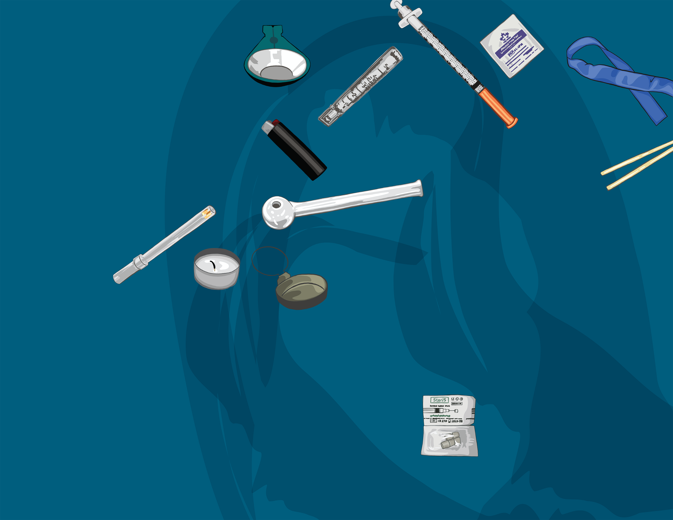
Maybe like images, lingo and stuff, so to have all the lingo written down. Everyone calls things different words. To have some kind of picture of it, and the words.
“
Quote from focus group participant

Slide 6
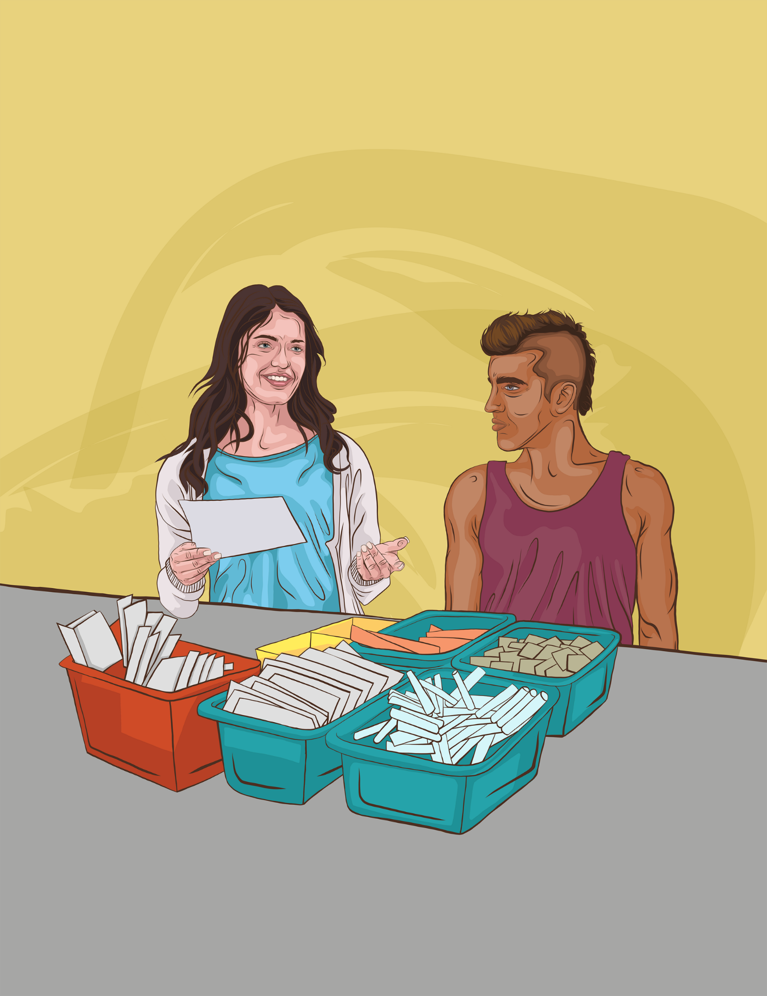
Something that’s easy to grab and look at when you don’t have much knowledge on something, but have a person asking you something. Bare bones – you’ll be like, “Let’s have a quick look together.”
“
Quote from focus group participant

Slide 7
A module for when someone’s new to the program, some sort of orientation that’s consistent that we know that every health unit is using, that everyone’s getting the same education
“
Quote from focus group participant

Slide 8
agenda
Welcome and Introductions | Netta Kornberg
Message of Congratulations | Karen Lomax
Project Overview | Nadia Zurba
Voices from the Field | Denise Beaumont
Components of the Guide | Josée Conway
Use Cases | Talia Storm, Meghanne Hicks, and Netta Kornberg
Q&A
Concluding Remarks | Nick Boyce

Slide 9
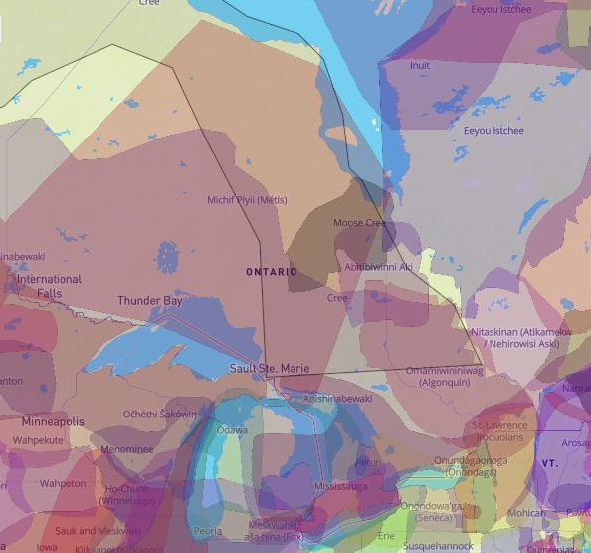
OHRN’s offices are located in what is known by many today as Toronto - the traditional territories of several Indigenous nations including the Mississaugas of the Credit, the Anishnabeg, the Chippewa, the Haudenosaunee and the Wendat peoples. But our work takes place across Ontario, which includes the ancestral and current homes of numerous and diverse Indigenous peoples.
Harm reduction is grounded in place – the specific contexts of the specific areas where we each work. We recognize these contexts are fundamentally shaped by the historical and contemporary presence and activities of Indigenous peoples. These contexts are also influenced by colonial, racist and classist drug laws and policies.
While those of us working in harm reduction support individual people who use drugs and their communities, we must also address and change the unjust systems that continue to negatively and disproportionately affect Indigenous peoples, who have been living on this land since time immemorial.
Map created by Native Land Digital
native-land.ca

Slide 10
Message of Congratulations
Karen Lomax
Overdose Prevention Coordinator
ARCH Guelph

Slide 11
Nadia Zurba
Manager
Ontario Harm Reduction Distribution Program
Project Overview

Slide 12
Denise Beaumont
Inventory Analyst
Ontario Harm Reduction Distribution Program
Voices from the Field

Slide 13
Focus Groups
London Guelph Toronto Owen Sound
Kenora Kingston Cornwall Brockville
8 groups with frontline staff
8 groups with clients

Slide 14
Focus Group Learnings
Insight into how harm reduction supplies are ordered and distributed
The Best Practice Recommendations for Harm Reduction Programs (BPRs) plays an important role in service planning and distribution of supplies and education
Client population can not only be different from region to region, but in different towns within a region.
Variance in staffing models
Scope of harm reduction services varies from site to site
Harm reduction training for new frontline staff in the majority of places is very informal

Slide 15
Components of the Guide
Josée Conway
Operations Coordinator
Ontario Harm Reduction Distribution Program

Slide 17
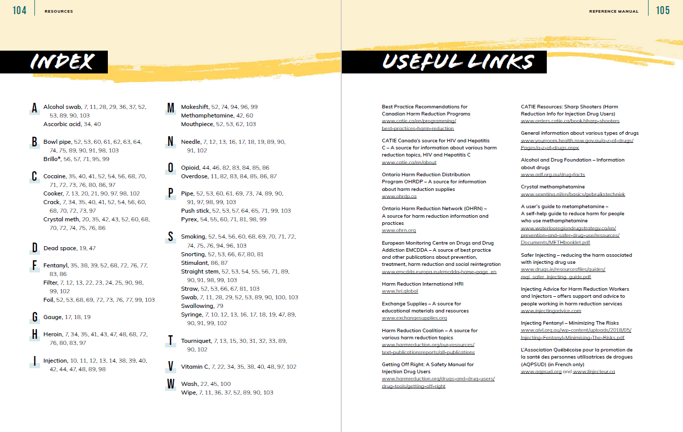

Slide 18
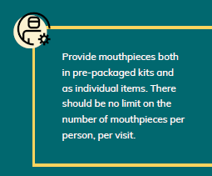
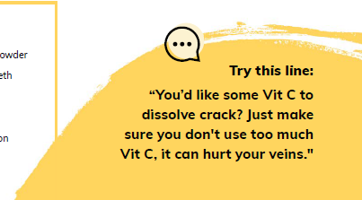

Slide 20
Use Cases
Meghanne Hicks
Registered Nurse
Addictions and Mental Health Services
Talia Storm
Manager
StreetWorks Services, Positive Living Niagara
Netta Kornberg
Knowledge Exchange Lead
Ontario Harm Reduction Network

Slide 21
Use Cases Overview
Types of Materials
Full Guide – print
Full Guide – digital
Guide Sections
Posters
Settings of use
Training
Work in the building
Work in the field
Find the Digital Guide + Posters at
ohrn.org/connecting

Slide 22
Put your questions in the Q&A box
Q&A

Slide 23
Nick Boyce
Director
Ontario Harm Reduction Network
Closing Remarks

Slide 24
ohrn.org
ohrdp.ca

